Slide 1
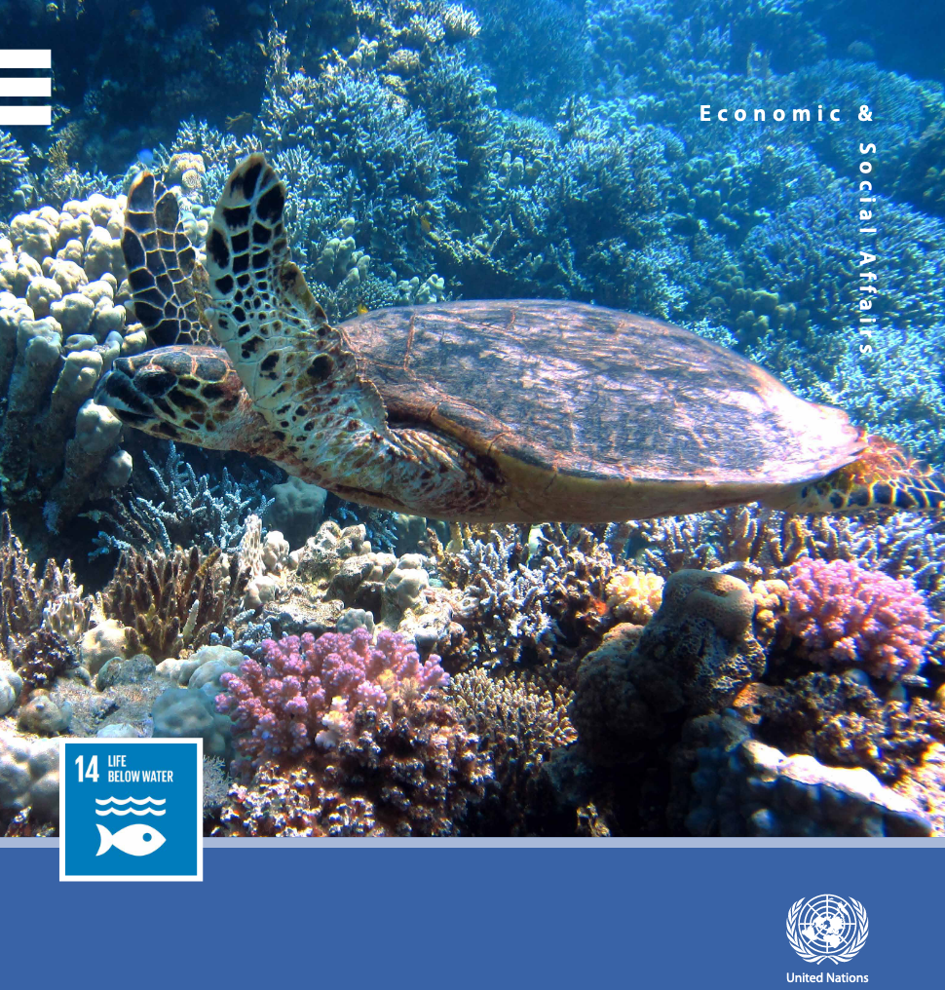
An assessment of impacts of the United Nations Ocean Conference Voluntary Commitments
Marjo Vierros
Coastal Policy and Humanities Research

Slide 2
UN Ocean Conference 2017
Voluntary commitments a key outcome of the 2017 UN Ocean Conference
Open to all stakeholders
High degree of inclusivity
Approximately 1400 registered initially
1628 commitments in late 2020 when report written
Now 1642 commitments
Registry remains open for new commitments
Continued interest by entities including governments, UN entities, IGOs, NGOs, civil society, academia, scientific community, private sector, philanthropic organizations, other relevant actors, partnerships
More than 3 years later, what has been their impact in advancing progress towards Goal 14 and its targets?

Slide 3
Assessing impact
Source materials for assessment:
Progress reports submitted by voluntary commitment holders
Questionnaire circulated by United Nations
Supplementary materials, such as:
Project websites
International databases (incl. World Database on Protected Areas)
Project reports, newsletters, evaluations and other materials
Reports from Communities of Ocean Action

Slide 4
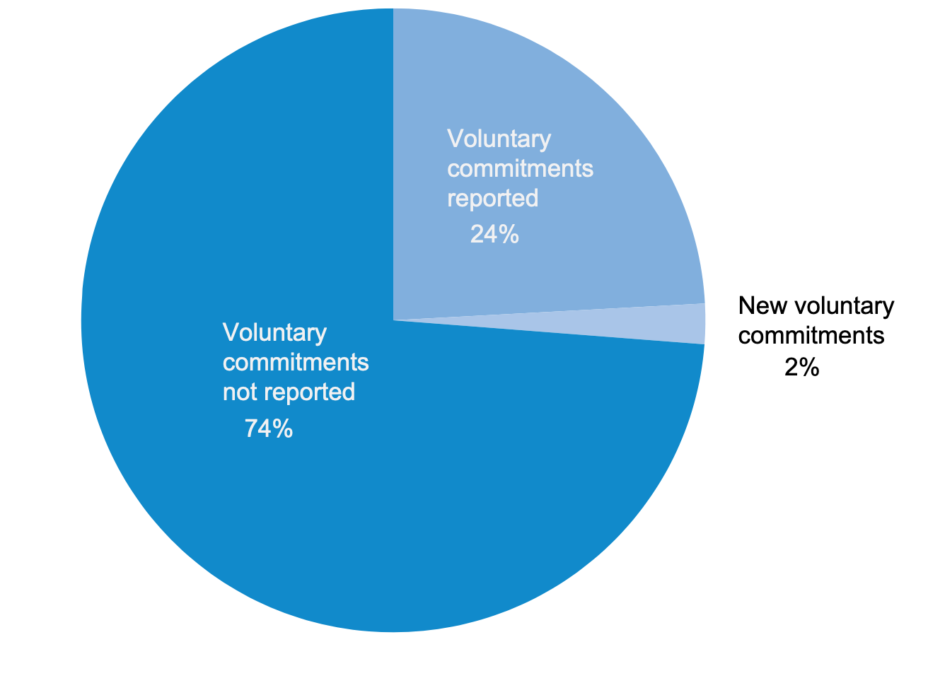
Reporting on voluntary commitments
Main difficulty: Low rate of reporting
Reporting rate ~24% overall
Commitments not reporting are likely still making progress, though some have now concluded
Gaps in reporting make it more difficult to assess contribution towards specific targets and SDG 14 overall
“Other relevant actors” highest reporting rate (48%) followed by UN entities (39%)
Philanthropic organizations lowest (14%) followed by governments (17%) and civil society organizations (18%)
Progress reports include all targets

Slide 5
Impacts by target: 14.1 on marine pollution
Summary of impacts
Major shift in public perception regarding single use plastics, marine litter microplastics
Considerable degree of grassroots actions by civil society – cleanups, education, awareness raising, toolkits
Commitment holders collectively removed over 2.1 million kg of marine debris from beaches, the water column and under water
Government bans on single use plastics, action plans, recycling, waste management have resulted in decrease in marine litter: visual impacts
Regional action plans and policies
Private sector initiatives on replacing single use plastics, preventing microplastics from entering the sea
Successes in reducing ship-based pollution and emissions
Challenges
Measurability – many commitments did not include monitoring
Financing, volunteer training
Regional and global collaboration in marine litter needs strengthening
Potential gaps
Need to address all aspects of plastics supply chain
global assistance and coordination is needed to provide a coherent response
Further action required on other forms of pollution, such as nutrients and sewage

Slide 6
Impacts by target: 14.2 on sustainable management and protection of marine ecosystems
Summary of impacts
Considerable progress in ecosystem approach, marine spatial planning, marine policies etc.
Blue carbon projects and ecosystem restoration have moved towards the mainstream
Climate resilience commitments have explored innovative solutions
Challenges
Lack of funding, staff, capacity
low level of awareness about oceans, climate change and the Sustainable Development Goals
Data comparability and quality
Potential gaps
Good progress but requires scaling up of solutions
The component of target 14.2 relating to “avoiding adverse impacts” has not been well implemented
Target came to term in 2020

Slide 7
Impacts by target: 14.3 on ocean acidification
Summary of impacts
Successful networking of scientists around the globe – partnerships
In total, 265 scientific and policy institutions globally participated in the networks contributing to target 14.3
Capacity of young scientists and female scientist built
Improved availability of data
Low-cost monitoring tools made available
Development of ocean acidification action plans – subnational, national, regional - including habitat restoration and adaptation
Challenges
Lack of resources and sustained long-term funding for observations
Gaps in observations (expensive equipment, capacity)
Limited awareness of ocean acidification
Potential gaps
Awareness raising and education, including among policymakers
Filling geographical gaps in observations
Better understanding adaptation to ocean acidification

Slide 8
Impacts by target: 14.4 on sustainable fisheries
Summary of impacts
Volume of catch certified as sustainable has increased
Ecosystem approach to fisheries and governance measures strengthened
Improvements in information, including for stock assessments
Seafood industry initiatives in sustainability
Support for Port States Measures Agreement to help combat IUU fishing
Improvements to monitoring and surveillance
By-catch mitigation
Challenges
Lack of capacity for sound fisheries management
Poor data on fish stock status
Monitoring, control and surveillance
Human rights issues in relation to fisheries
Potential gaps
More needs to be done on a larger scale
Reduction of pre- and post-harvest loss and waste
Additional efforts to transition to ecosystem-based fisheries management and to improve governance

Slide 9
Impacts by target: 14.5 – at least 10% conservation by 2020
Summary of impacts
New MPAs covering 3.3 million km² established
Includes commitments by governments, NGOs and funding agencies – active donor support
Increased collaboration and networking between MPA sites
Increased stewardship through local management of marine areas
Challenges
Many MPAs lack permanent funding for operating costs and management measures
Capacity for stakeholder engagement, consultations, ownership
Potential gaps
Ecological representativity, functionality and connectivity of existing MPAs
Climate change considerations in MPA design
Management effectiveness, capacity and long-term financing
Monitoring ecological and socio-economic impacts of MPAs
Came to term in 2020 – the CBD post-2020 Global Biodiversity Framework will offer future direction

Slide 10
Impacts by target: 14.6 on prohibiting harmful fisheries subsidies
Summary of impacts
Progress on information sharing
Currently at the hands of WTO negotiators
Target also expires in 2020

Slide 11
Impacts by target: 14.7 on increasing economic benefits to SIDS and LDCs from sustainable use of marine resources
Summary of impacts
Evaluation of target suffers from under-reporting of many excellent initiatives
Progress being made in blue economy transitions in countries reporting
Some models of innovative financing that could be scaled up
Progress in some sectors: fisheries, aquaculture
Challenges
Sustainable finance for blue economy transition
Other resources: staff, expertise
Coordination among multiple stakeholders
Potential gaps
Sectoral participation: aquaculture, marine biotechnology, renewable energy

Slide 12
Impacts by target: 14.A on increased scientific knowledge, capacity and technology
Summary of impacts
Progress in global ocean observation and monitoring, including new techniques in tracking for migratory species and DNA for genetic diversity
Newer networks with focus in interdisciplinary science and science policy interface
Large number of capacity development initiatives, with some technology transfer
Challenges
Funding
Access to data, locating data
Potential gaps
Socio-economic information relating to the ocean
Information relating to under-surveyed regions, some species and the deep sea
Capacity and technology gaps require long term partnerships to address

Slide 13
Impacts by target: 14.B on small-scale artisanal fishers access to resources and markets
Summary of impacts
Some excellent commitments but relatively few collective impacts recorded
Access to resources and participation in resource management increased in certain regions, locations
Access to markets enhanced on the local scale
Some small-scale and artisanal fisheries certified
Capacity development on a range of locally important topics
Improvements to available information to better understand role of small-scale fisheries globally
Challenges
Important to continuously strengthen fisher organizations
Recognition of traditional knowledge in fishing and right to decent work
Certification still presents challenges
Lack of data collection and scarcity of data
Potential gaps
Implementation of target requires further action across a broader range of countries

Slide 14
Impacts by target: 14.C on implementation of international law as reflected in UNCLOS
Summary of impacts
Improvements in available information about UNCLOS and international law
Progress made in cross-sectoral regional cooperation and governance
Examples of new regional action plans
Challenges
Sectoral and often fragmented nature of ocean governance
Complex administrative, political and legal nature of the activities
Potential gaps
Many stakeholders will likely require further assistance in better understanding and implementing UNCLOS
Scaling up good cross-sectoral governance examples

Slide 15
Other impacts of voluntary commitments
Voluntary commitments have had a large collective impact on raising awareness about the ocean and its importance
Awareness-raising activities focusing on youth
Provision of employment, including for women
Benefits to marginalized groups, fishing communities, single mothers, Indigenous Peoples
Agenda 2030: Leave no one behind

Slide 16
Lessons learned from voluntary commitments: building on the bright spots
1. Grassroots momentum is powerful
Many local initiatives, started small and built momentum through social media etc.
Minimal funding, relied on volunteers and donations
Over time, and collectively, they achieved considerable results
2. Partnerships are key to success
Expanding on initiatives and making them increasingly impactful requires partnerships
Step up from grassroots action in their level of organization, and they require the development of a common vision and actions to achieve that vision
Partnerships often started smaller and have expanded their reach, including to multiple countries
Have often included capacity development and mentoring relationships

Slide 17
Lessons learned from voluntary commitments: building on the bright spots
3. Expanding networks will help scale up successful initiatives
Networks grow over time, providing an opportunity to expand successful national initiatives (eg. Regional networks of MPAs)
New knowledge and creative solutions through inter-regional learning, South-South cooperation
While local solutions are often the most creative, pressing global problems will require global solutions (plastics, ocean-climate change nexus)
Communicating local solutions to a global audience
4. Sustainable, shock-proof funding is important for long-term impact
COVID-19 has demonstrated precariousness of funding for many marine conservation initiatives
Diverse, sustainable and innovative long-term financing solutions are now more important than ever
Important models can be found in the voluntary commitments

Slide 18
Moving forward: keeping the inclusivity but providing for accountability
The voluntary commitments have been a success in providing for inclusive participation of all ocean stakeholders from the local to the global levels
New approaches have been pioneered to keep momentum going, such as the Communities of Ocean Action
While these have achieved success, voluntary commitments overall suffer from lack of reporting
To improve reporting, commitment holders should be encouraged to undertake simple monitoring with baseline and agreed-upon metrics
Important not to discourage commitments, but to provide for accountability
Also moving forward, will require targeted commitments to fill gaps, scale up successful solutions

Slide 19
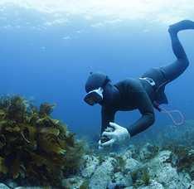
Thank you!

